Slide 1
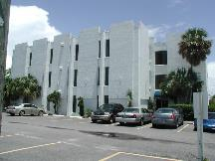
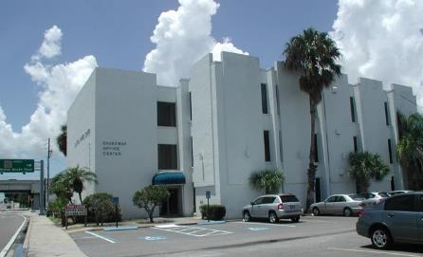
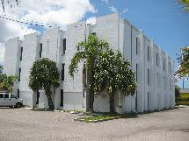
CAUSEWAY OFFICE CENTER
INVESTMENT OVERVIEW

Slide 2
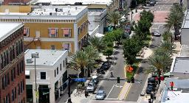
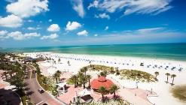
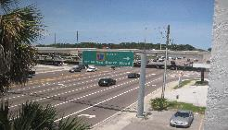
LOCATION, LOCATION, LOCATION
At 3118 Gulf to Bay Blvd, just East of the Bayside Bridge in Clearwater Florida. Convenient to St. Petersburg Airport and Tampa Airport. The property is the tallest structure direct on the North-East corner of the intersection of Highway 611 McMullan and Highway 60 Gulf to Bay Blvd. The Clearwater causeway is the main driving connection between Tampa and Clearwater. The Tampa Bay Beach is only 400 yards to the property.
Downtown Clearwater
Clearwater Beach
Major Intersection
Less than 10 minutes away from Downtown Clearwater. Popular sites of attraction include the Clearwater aquarium. Less than 20 minutes from St. Petersburg, a beautiful culture filled city with various living areas and attractions i.e. Dali Museum
Located only 15 minutes away away from Clearwater beach that is known for its beautiful white sand beaches and activity filled city. Over 1.8 million people visit clear water beach annually
Major intersection on Highway 60 and 611 both have a traffic count over 59 000 cars daily. The building is located in an excellent advertising area exposed to thousands of people daily.

Slide 3
PROPERTY DISCRIPTION
Stories: 3
Floor Finish: Carpet Combination
Interior Finish: Dry Wall
Fixtures: 30
Year Built: 1972
Effective Age: 44
Cooling: Heat & Cooling Pkg

Slide 4
SALES HISTORY
Sold in 1989 to present owner for $ 1,000,000
The property was under contract in 2015 with a buyer who intended to purchase the lot to the West side and the apartment building to the North for a major development site. As they were unable to complete the acquisition of the other lots their purchase of 3118 Gulf to Bay Blvd was cancelled.

Slide 5
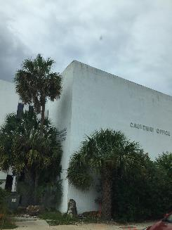
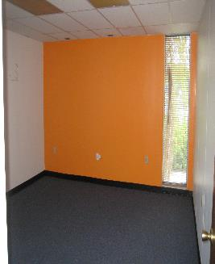
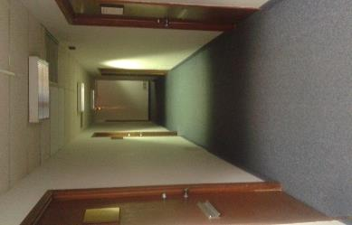
OFFICE CONDITIONS
The condition of the offices is good and can be rented without major repair or renovation. Improvement and some modernization will be required in the Lobby area and Elevator.

Slide 6
FINANCING AND LEASING
Total rentable SF of 19,348 offered at a below market leasing price of $ 17 / SF, the total potential income for the property is $ 327,600 per year.
We have financing of $ 570,000 for 6% with a 20 year term in place. The monthly interest payment for the loan will be $ 2,850 in interest per month.
Considering a potential income of $ 327,600 / 12 = $ 27,300 per month, will make clear why we are confident that the property has substantial upside potential.
The property was under contract for one year and the prior owner had not marketed the leasing space. At 70% occupancy rate we will be able to refinance the building and repay investors. We expect that such increase in occupancy will take place in 6 – 12 months.

Slide 7
FUNDS REQUIRED AND USE
$ 280,000
Cash to close acquisition
Closing cost
Architect / Engineer for Mix use change
General Improvements / Upgrade
Rooftop Terrace
Reserves
Funding:
$ 450,000 Limited Partners
$ 50,000 General Partner
$ 30,000
$ 10,000
$ 130,000
$ 20,000
$ 30,000
total $ 500,000 required

Slide 8
INVESTMENT OFFER:
Minimum investment $ 50,000 per unit for 9 units.
Repayment of investment with refinancing of property after 70% occupancy / leasing
New mortgage to be placed on the property with higher income and occupancy.
At $850,000.00 the purchase price of property is $36.48 per SF
Replacement value of property at $100.00 per SF only = $2,300,000
The Investment will be paid back in full, after that your equity interest will earn a minimum of 12% return per year of your invested amount.

Slide 9
CASH FLOW ANALYSIS
Income | June 2016 Per month present | June 33% occupancy Per year | December 2016 50% occupancy | Annual income 50% occupancy | March 2017 75% occupancy | Annual income 66% occupancy | June 2017 Income 85% occupancy | Annual income 85% occupancy
Rent | $ 6,062 | $ 72,743 | $ 9,250 | $ 111,000 | $ 12,210 | $ 146,520 | $ 15,725 | $ 188,700
Common |  |  | $ 2,500 | $ 30,000 | $ 3,500 | $ 42,000 | $ 4,600 | $ 55,200
Utilities |  |  | $ 1,450 | $ 17,400 | $ 2,500 | $ 30,000 | $ 2,900 | $ 34,800
Total |  | $ 72,743 |  | $ 158,400 |  | $ 218,520 |  | $ 278,700
At 100% occupancy the total monthly income will be $ 27,300 and the annual income $ 327,800
Expense
Advertisement Managemnt | $ 120 | $ 1,440 |  | 1,500 6,000 |  | 1,500 12,000 |  | 1,500 12,000
Insurance Flood Liability Property | $ 100 $ 125 $ 325 | $ 1,200 $ 1,500 $ 3,900 |  | 1,200 1,500 3,900 |  | 1,200 1,500 3,900 |  | 1,200 1,500 3,900
Janitor Serv | $ 950 | $ 11,400 |  | 12,000 |  | 12,000 |  | 12,000
Ground Maint | $ 100 | $ 1,200 |  | 1,200 |  | 1,200 |  | 1,200
Pest Control | $ 58 | $ 700 |  | 1,000 |  | 1,000 |  | 1,000
Operating Sup | $ 200 | $ 2,400 |  | 3,000 |  | 3,000 |  | 3,000
R.E.Taxes | $ 967 | $ 11,600 |  | 11,600 |  | 11,600 |  | 11,600
Repairs | $ 450 | $ 5,400 |  | 5,400 |  | 5.400 |  | 6,000
Utilities |  | $ 21,000 |  | 21,000 |  | 21,000 |  | 24,000
 |  | $ 61,740 |  | 69,300 |  | 77,300 |  | 78,900
Income |  | $ 72,743 |  | 158.400 |  | 218,500 |  | 278,700
Expense |  | ($ 61,740) |  | (69,300) |  | (77,300) |  | (78,900)
Net Income before DS |  | $ 11,003 |  | $ 89.100 |  | 141,200 |  | 199,800
PROPERTY VALUE WITH NET INCOME OF $ 200,000 PER YEAR, 7% CAP RATE = $ 2,850,000

Slide 10
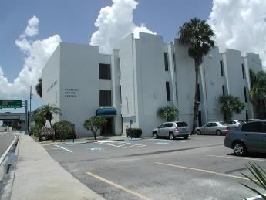
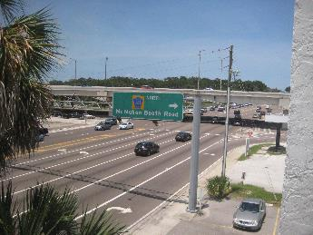
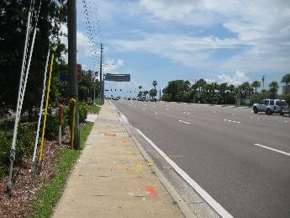
STREET VIEW
Front View
Rear-end View
West-side View
East-side View

Slide 11
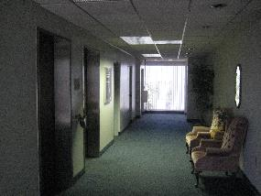
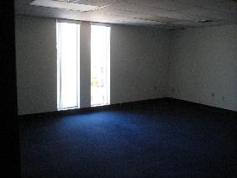
Interior view:
Lobby
Office Space
Office Space

Slide 12
OFFICE PROPERTY ASKING PRICE- Sale Trends
Current Clearwater market trends data indicates an increase of +2.8% in the median asking price per sq. ft. for Office properties compared to the prior 3 months, with an increase of +10.5% compared to last year's prices. County-wide, asking prices for Office properties are 3.3% higher at $122 per sq. ft. compared to the current median price of $113 per sq. ft. for Office properties in Clearwater, FL.
Apr 16 vs. 3 mo. prior Y-O-Y
State $141.39 +1.9% +4.5%
Metro $124.93 +1.9% +2.9%
County $121.88 +3.3% +11.4%
City $112.78 +2.8% +10.5%

Slide 13
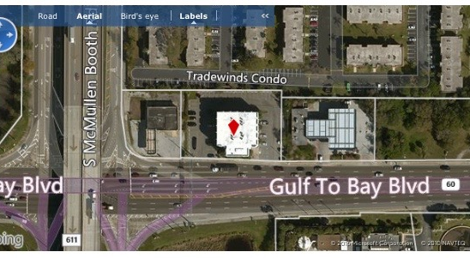
MAP VIEW

Slide 14
SAFE HARBOUR STATEMENT
This presentation contains “forward-looking statements” within the meaning of the Private Securities Litigation Reform Act of 1995. These forward-looking statements include statements relating to anticipated financial performance, business prospects, new developments, pending transactions and similar matters, and/or statements that use words such as "anticipates," "estimates," "expects," "intends," "believes“, “projects” and similar expressions. These forward-looking statements are estimates reflecting the best judgment of senior management, and involve a number of risks and uncertainties that could cause actual results to differ materially from those suggested by the forward-looking statements. Other unknown or unpredictable factors also could have material adverse effects on Causeway Office future results, performance or achievements. In light of these risks and uncertainties, the forward-looking events discussed in this presentation may not occur. You are cautioned not to place undue reliance on these forward-looking statements, which speak only as of the date stated, or if no date is stated, as of the date of this presentation. Causeway Office is not under any obligation and does not intend to make publicly available any update or other revisions to any of the forward-looking statements contained in this presentation to reflect circumstances existing after the date of this presentation or to reflect the occurrence of future events even if experience or future events make it clear that any expected results expressed or implied by those forward-looking statements will not be realized.

Slide 15
CONTACT INFORMATION
WB FINANCIAL, LLC
715 East Bird Street
Tampa, FL 33604
PHONE: 786-436-6362
EMAIL: ap@wbfinancialadvisors.com
www.wbfinancialllc.com

